Slide 1
What Every Hacker Should Know About TLB Invalidation
December 2024
Hackers to Hackers Conference (H2HC)
Paweł Wieczorkiewicz
Open Source Security, Inc.

Slide 2
PAWEŁ WIECZORKIEWICZ EMAIL: WIPAWEL@GRSECURITY.NET TWITTER / X: @WIPAWEL
Security Researcher at Open Source Security, Inc. (creators of grsecurity®)
Low-level security research of system software and hardware
Reverse engineering and binary analysis
Kernel Test Framework (KTF)
creator and maintainer https://github.com/KernelTestFramework/ktf

Slide 3
Outline
Theory
What is TLB?
What is the purpose of TLB?
Paging-structure caches demystified
Basic whys and whens of TLB invalidation
Optimizations
Global Pages
PCID and VPID
Details of TLB invalidation
Practice
An interesting case study of a PaX/grsecurity PRIVATE KSTACKS bug
A case of broken INVLPG instruction on new generations of Intel CPUs

Slide 4
What is the Translation-Lookaside Buffer (TLB)?

Slide 5
What is the Translation-Lookaside Buffer (TLB)?
Virtual Memory (VM) and Memory Management Unit (MMU)
A simplified view:
Software operates within many various virtual address spaces
Hardware operates within a single physical address space
Virtual address != physical address
Translation is needed

Slide 6
What is the Translation-Lookaside Buffer (TLB)?
Virtual Memory (VM) and Memory Management Unit (MMU)
A simplified view:
Software operates within many various virtual address spaces
Hardware operates within a single physical address space
Virtual address != physical address
Translation is needed
Paging and page tables
Implementation “detail” of Virtual Memory
Physical memory split into frames of standard sizes (4K, 2M, 1G)
Virtual memory address space split into pages of physical frames sizes
Physical frames mapped to virtual address spaces to back virtual memory pages
Extra metadata of virtual memory pages: Present, Read/Write, User/Superuser, …

Slide 7
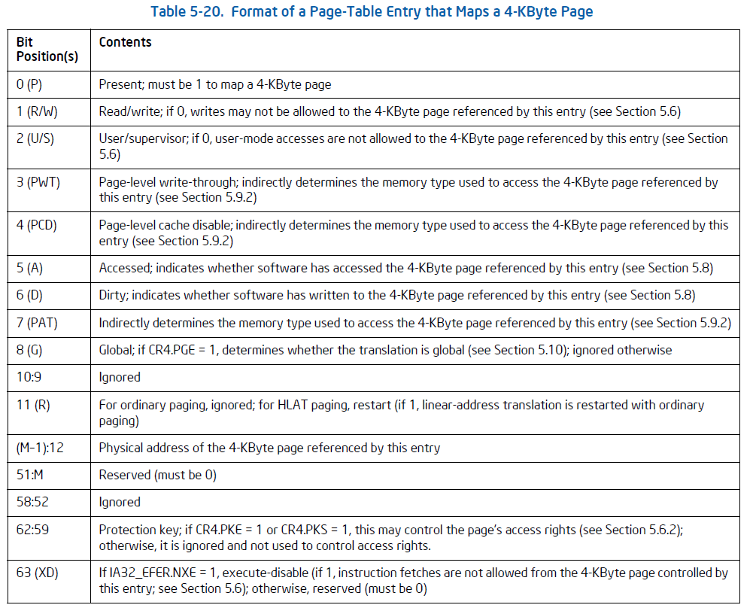
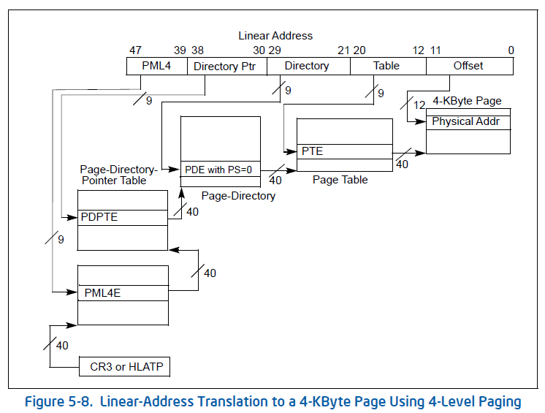
What is the Translation-Lookaside Buffer (TLB)?
Example schematic of 4-level page tables
Format of typical 4K virtual memory page
Source: Intel® 64 and IA-32 Architectures Software Developer’s Manual

Slide 8
What is the Translation-Lookaside Buffer (TLB)?
Virtual Memory (VM) and Memory Management Unit (MMU)
Paging and page tables – page walk
Every time a virtual address is being accessed by SW → CPU has to perform a page walk
CPU has dedicated page walk HW units to perform this process transparently
A page walk begins by getting physical address of a top page table from a dedicated register (CR3 on x86)
This table memory has to be fetched, indexed, metadata flags need to be examined
From the fetched and indexed table next level page table physical address is obtained
Again, this table memory has to be fetched, indexed, metadata flags need to be examined
This traversing continues until the lowest level of the page table hierarchy provides actual memory address
This process is very expensive

Slide 9
What is the Translation-Lookaside Buffer (TLB)?
TLB is a (set of) cache buffer(s) automatically storing previous, successful page walk results
TLB caches recent virtual address to physical address translations …
… and a summary of traversed page table entries metadata flags

Slide 10
What is the Translation-Lookaside Buffer (TLB)?
TLB is a (set of) cache buffer(s) automatically storing previous, successful page walk results
TLB caches recent virtual address to physical address translations …
… and a summary of traversed page table entries metadata flags
Typical TLB consists of entries referenced by a virtual page number (e.g. virtual address >> 12)
Typical TLB entry consists of:
Physical frame number (physical address = (frame number << 12) + offset)
Access rights from page tables’ entries used for the translation:
Logical AND of Read/Write flags
Logical AND of User/Superuser flags
Additional page table metadata attributes

Slide 11
What is the Translation-Lookaside Buffer (TLB)?
Organization of TLB hardware may differ across various CPU microarchitectures
TLB can be split into independent: instruction TLB (iTLB) and data TLB (dTLB)
Different number of entries
Due to different spatial and temporal characteristics of accesses
Different metadata flags cached
For example: code does not need a dirty flag
Multiple levels of TLB buffers
For example:
First level: iTLB + dTLB
Second level: unified TLB

Slide 12
What is the purpose of TLB?
Probably obvious at that point → PERFORMANCE
TLB caches recent translations obtained with expensive page walks
A principle of temporal locality applies:
Recently used virtual memory page is likely to be re-used again soon
Each TLB Hit is a huge win
TLB acting as an intermediate cache allows to:
Pipeline and/or parallelize fast TLB Hits with slow TLB Misses
Outsource expensive and slow work to hardware page walk units …
… while keep serving TLB Hits quickly

Slide 13
TLB quirks and peculiarities

Slide 14
TLB quirks and peculiarities
TLB caches entries only for successful page walks
Each page table level entry used for a translation has to have:
Present flag set
Reserved bits zeroed
Intel SDM:
“the processor does not cache a translation for a page number unless the accessed flag is 1 in each of the paging-structure entries used during translation…”
Software can use it for deciding if invalidation is needed
“… before caching a translation, the processor sets any of these accessed flags that is not already 1”
This can be used for page walk detections
This obviously affects the need for invalidation

Slide 15
TLB quirks and peculiarities
Intel SDM: “the processor may cache a translation for any linear address, even if that address is not used to access memory”
TLB may store for example:
Translations for memory prefetches
“accesses that result from speculative execution that would never actually occur in the executed code path”
Side-channels, side-channels everywhere!
Intel SDM: “On a processor supporting Hyper-Threading Technology, invalidations performed on one logical processor may invalidate entries in the TLBs and paging-structure caches used by other logical processors”
In other words: making assumptions about presence or absence of TLB entries is risky!

Slide 16
TLB quirks and peculiarities
TLB may cache a huge page (e.g. 2M or 1G) translation as multiple 4K pages translations
This implementation detail is not visible to software
It may complicate explicit invalidation requirements for such huge page translation
TLB may contain several distinct translations for the same physical memory addresses at once
For example:
TLB contains an existing 4K virtual page translation
Software modifies a corresponding page table entry, so the virtual page size changes (e.g. 2M)
Accessing the virtual page now may lead to allocating a completely new TLB entry
Which entry should be used for subsequent accesses?
Intel SDM: “Which translation is used may vary from one execution to another, and the choice may be implementation-specific”
Making assumptions is risky again!

Slide 17
An introduction to paging-structure caches

Slide 18
Introduction to paging-structure caches
TLB is not the only cache buffer used for optimizing expensive page walks
Modern CPUs usually implement also caches for higher-level page table entries
In addition to the TLB’s:
A memory address final translation
Obtained from the lowest-level page table entry
A summary of all-level page table entries metadata flags

Slide 19
Introduction to paging-structure caches
The principle of temporal and spatial locality applies again:
Regardless of a TLB capacity and its state, the same higher-level page table entries may be re-used frequently
Because they participate in mapping larger portions of virtual address spaces…
… or may be used by cross-address-space mappings of common, shared data (e.g. kernel code, libraries)
Caching them may noticeably improve performance of many workloads on modern OSes
Typically distinct paging-structure caches exists for all higher-level page tables
Caching higher-level page table entries help reduce a page walk cost → performance
Any cache hit shortens the page walk
The lower the level → the shorter the page walk necessary

Slide 20
Introduction to paging-structure caches
Exemplary PDPTE (3rd level page table) cache properties
Entries indexed with only a part of the virtual address – depending on the paging mode
Example: 4-level paging mode → bits 47:30, just 18 bits
Typical cache size is small – depends on a CPU microarchitecture implementation
Entries contain:
Physical address of a PDE page table (2nd level page table)
A summary of this and higher-level page tables entries metadata flags
Logical AND for: Read/Write and User/Superuser
… etc
Similar characteristics and properties apply to all other (higher and lower level) paging-structure caches

Slide 21
Paging-structure caches – more details
Huge pages entries are not cached in paging-structure caches
1G pages have PS bit set in the 3rd level page table entries
No need for lower-level page table entries
2M pages have PS bit set in the 2nd level page table entries
No need for PTE
These are handled by TLB
Similarly to TLB requirements:
Only entries of present and valid (no reserved bits set) pages are cached
Accessed flags of the page table entries involved in the page walk are set by the CPU

Slide 22
Paging-structure caches – more details
According to documentation: CPU is free to create a paging-structure cache entry at any time
Even when there are no translations for virtual addresses using the entry
Similar to the TLB case:
“The processor may create entries in paging-structure caches for translations required for prefetches and or accesses that are a result of speculative execution that would never actually occur in the executed code path”
Already created cache entry may remain unmodified regardless of software’s subsequent modifications to the page tables
Need to explicitly invalidate
Entries are associated with the current PCID – more on this later

Slide 23
TLB and paging-structure caches interaction
How does CPU use TLB with paging-structure caches?
In case of a direct TLB hit → TLB entry data is used immediately
In case of a TLB miss:
Paging-structure cache for 2nd level page table entries (PDE) may be consulted
In case of a cache hit → quick page walk (just PTE is needed)
In case of a cache miss:
Paging-structure cache for 3rd level page table entries (PDPTE) may be consulted
In case of a cache hit → shorter page walk (just PDE and PTE needed)
In case of a cache miss: …
… and so on depending on the caches available…
If CPU misses in all the caches → a full page walk is scheduled

Slide 24
Why and when a TLB invalidation is needed?

Slide 25
TLB invalidation – why?
In case of a TLB hit:
CPU may use found TLB entry to determine a page frame, access rights, and other attributes
CPU will likely NOT consult the page tables in memory
As mentioned earlier:
“The processor may retain a TLB entry unmodified even if software subsequently modifies the relevant paging-structure entries in memory”
… and same is true for paging-structure caches!
In other words:
Invalidation is needed to maintain coherency between translation caches (TLB, paging-structure caches) and page tables in memory at all times
Without this coherency: system stability and security is gone

Slide 26
TLB invalidation – when?
Whenever the in-memory page table entries and their potentially cached values might be out-of-sync?
Excellent guarantees, but terrible performance
Whenever software modifies page tables?
Not necessarily, remember the requirements for caching (Present bit set, etc)
Some modifications can assume the entry is not in cache
Whenever virtual address space changes?
Whenever one process (page table A) is context switched into another process (page table B)?
What if they share some memory pages?
What about common kernel code?

Slide 27
TLB invalidation – when?
Invalidating too much is very bad for performance
Operating systems try to invalidate only:
When necessary and …
… what really needs to be flushed
Invalidating too little however makes performance not matter at all
In real-life situations discussed later, we will see how problematic this can be
Some optimization assumptions might not hold …
… and be super complex to reason about
And… of course… a broken CPU microcode...

Slide 28
Hardware optimizations

Slide 29
Hardware optimizations
Hardware features have been added to CPUs in order to:
Help software maintain the translation cache coherency more efficiently
Eliminate unnecessary invalidation of frequently used translation entries
The features:
Global Pages
Process Context Identifiers (PCID)
Virtual Processor Identifier (VPID) – virtualization feature (vCPU tagging)
All the features are optional, but can be also used all together
Most if not all of modern OSes use PCID
Some of the OSes additionally rely on Global Pages
Examples: FreeBSD

Slide 30
Hardware optimizations – Global Pages
Global Pages feature was added to limit unnecessary invalidations of frequently used pages
For example: shared memory pages between different virtual address spaces
Common code (libraries)
Always mapped-in kernel memory
Whenever virtual address space is being changed (on a task switch or process context switch)
The corresponding page tables have to be changed as well
Thereby, on x86 a full TLB flush is triggered by:
All writes to the CR3 register
A hardware task switch
Flushing and then hitting TLB misses for the same memory accesses is a waste

Slide 31
Hardware optimizations – Global Pages
Enabling Global Pages feature (PGE bit of CR4 on x86) makes CPU respect addition flag in page table entries
Global flag (G)
Software can decide what are the shared or frequently used virtual memory pages and mark them as global
By setting the G bit in their lowest-level page table entry
Note: there is no G bit for higher-level page table entries
When enabled, TLB entries with a global flag are not invalidated automatically when page tables are reloaded
Automatic avoidance of TLB misses for shared memory

Slide 32
Hardware optimizations – Global Pages
However…
Global pages take up TLB entries
A good balance is needed to avoid TLB thrashing
Invalidation of global pages is more complicated
Might not be worth it, when it has to occur often
Some quirks:
Global pages do not affect the behavior of paging-structure caches at all
Only higher-level page table entries cached there
Global pages entries in TLB might be used by CPU regardless of their specific PCID
Global means global after all… it’s getting complicated

Slide 33
Hardware optimizations – Process-Context Identifiers (PCID)
PCID feature was added to limit the need for translations invalidation
It enables software to tag different virtual address spaces with different (almost) unique identifiers
… and thereby allows CPUs to easily distinguish between different virtual address spaces (tag matching)
CPU can consume cached translations only for the current address space (current PCID)
No need to invalidate other virtual address space translations proactively
Hardware will flush translation entries when it needs space for new ones (e.g. using LRU algorithm)
Frequently used translations, even from different address spaces, can remain in the translation caches
Maintenance simplification
Big potential performance gain

Slide 34
Hardware optimizations – Process-Context Identifiers (PCID)
PCID is a 12 bit identifier → up to 4096 different virtual address spaces can coexist
PCID of zero is the default (also: current) one
Setting PCIDE bit in CR4 register (on x86) enables non-zero PCIDs
The current address space PCID is indicated by the 12 LSB bits of the CR3 register (x86)
Switching page tables during process context switch allows to specify different PCID
CPU creates entries in TLB and paging-structure caches tagged with the current PCID
… and uses only those entries that are tagged with the current PCID (unless global)
Hardware-level logical address space translations isolation
Disabling PCID (via unsetting PCIDE bit in CR4) triggers entire translation cache hierarchy invalidation
PCID of zero becomes again the current and only one PCID

Slide 35
TLB Invalidation details…

Slide 36
Operations triggering TLB invalidation
x86 instructions:
INVLPG <virtual address>
Invalidates any TLB entry for the specified virtual address and current PCID
Invalidates any global page TLB entry for the specified virtual address for all PCIDs
Invalidates all entries in all paging-structure caches for all virtual addresses of the current PCID
INVPCID <type>, <descriptor>
Descriptor points at 128 bit memory structure, where virtual address and PCID are specified
Type operand controls the scope of invalidation:
(0) Address – invalidates any TLB entry (not global) for the descriptor’s virtual address and PCID
(1) Single context – invalidates all TLB entries (not global) for the descriptor’s PCID
(2) All contexts with globals – invalidates all TLB entries for all virtual addresses and all PCIDs
(3) All contexts – invalidates all TLB entries (not global) for all virtual addresses and all PCIDs
Invalidates entries in all paging-structure caches according to the type and descriptor operands

Slide 37
Operations triggering TLB invalidation
Other operations:
Disabling paging (e.g. unsetting PG bit of CR0 on x86)
No surprises here – invalidates everything everywhere
Page table switch (e.g. writing to CR3 on x86)
With PCID disabled – all TLB (but no globals) and paging-structure caches entries
With PCID enabled – depends on the MSB (63) bit of the CR3 value
0 – invalidates all TLB (no globals) and paging-structure caches entries for a new PCID
1 – no invalidation (utilizing PCID feature isolation capabilities)
Disabling/Enabling of Global Pages feature
Invalidates everything everywhere
Disabling of the PCID feature
Invalidates everything everywhere

Slide 38
Operations triggering TLB invalidation
Exceptions:
Page Fault exception (#PF) also invalidates entries in TLB and paging-structure caches
#PF exceptions result from accessing a virtual memory address
Various reasons: page not present, read-only, privilege violation, …
Upon #PF the following happens:
TLB entries for the #PF virtual address (stored in CR2 on x86) and current PCID are invalidated
Only paging-structure caches entries relevant for the virtual address translation and current PCID are invalidated
#PF induced invalidations are to prevent reoccurring exceptions due to stale translation caches entries
Virtualization transitions (VMEnter and VMExit) also invalidate TLB and paging-structure caches entries

Slide 39
TLB Shootdown – inter-processor invalidation
TLB and paging-structure caches are typically per logical CPU resources - each logical CPU has their own
On processors with multiple cores and/or supporting hyperthreading coordinated invalidations may be required
Upon modification of the in-memory page tables multiple CPUs may contain stale translation entries
Not enough for the page table modifying CPU to invalidate only its own translation caches
A TLB Shootdown operation must be initiated, so the translation cache hierarchy across all CPUs is in sync
TLB Shootdown:
Usually implemented using execution barriers and inter-processor interrupts (IPI)
Procedure overview:
Initiating CPU before the in-memory page table modification traps all necessary CPU on a barrier
… modifies the page table and performs its own invalidation
… signals to the trapped CPUs to perform their invalidation
All CPUs resume execution

Slide 40
When software has to invalidate TLB?
Modification of a page table entry mapping a virtual memory page
Software should issue INVLPG for all related virtual addresses
One INVLPG per page number is enough
Modification of a page table entry mapping another page table entry
I.e. modification of a higher-level page table
Depending on the target page table’s mappings count and their types:
Many mappings: full invalidation (e.g. via CR3 register write) might be the best choice
Otherwise, individual INVLPG invalidations for the mappings might be optimal
Even if there is none – e.g. target page table entries have all pages not present
Still at least one INVLPG is necessary!
Why? You will see later…

Slide 41
When software has to invalidate TLB?
Modification of a page table entry size
Huge page mapping
May lead to multiple translations in TLB for the same virtual addresses
One for the new huge page and one or more for the previous 4K pages
CPU may use any of the available translations
To avoid this, software has to first invalidate all affected translations
Page table entry modification write might get re-ordered and get executed after a subsequent memory access
This can create a stale translation entry
Invalidation instructions are all serializing instructions

Slide 42
When software has to invalidate TLB?
PCID identifier re-use
PCID value space is relatively small (12 bit – 4096 distinct values)
There may be more than 4096 virtual address spaces running concurrently on a system
Software has to re-use same PCID for different virtual address spaces
To avoid collisions in TLB and paging-structure caches:
Invalidate all translations for the new PCID
The CR3 bit 63 serves that purpose, but does not invalidate global entries
For global entries more drastic measures have to be used:
All context with globals INVPCID
Disable → Enable Global Pages

Slide 43
When software does not have to invalidate?
Modification of a page table entry mapping a non-present virtual page
Translations for non-present pages are not cached (neither in TLB nor paging-structure caches)
In other words: making a non-present page present does not require invalidation
Unless the page was present before and no invalidation has occurred since!
Modifying access flag of a page table entry
0 -> 1 – neither TLB nor paging-structure caches stores translations for untouched entries
1 -> 0 – without invalidation CPU might not set the flag on a subsequent access – not fatal
Modifying Read/Write flag of a page table entry
Read-only → Writeable – without invalidation #PF exception may occur
Not fatal, but sub-optimal
#PF will invalidate the cached translations
Writeable → Read-only – fatal without invalidation

Slide 44
When software does not have to invalidate?
Modifying User/Superuser flag of a page table entry
User → Superuser – fatal without invalidation
Superuser → User - without invalidation #PF exception may occur
Not fatal, but sub-optimal
#PF will invalidate the cached translations
Modifying dirty flag of a page table entry
1 -> 0 – without invalidation CPU might not set the flag on a subsequent write – not fatal

Slide 45
When software does not have to invalidate immediately?
Intel SDM quote: “The processor may retain entries in the TLBs and paging-structure caches for an extended period of time. Software should not assume that the processor will not use entries associated with a linear address simply because time has passed”
Example: unmapping (or remapping) a part of a virtual address space
Unsetting page table entries Present flag
Two cases:
(case 1) Page table entry mapping a page
(case 2) Page table entry mapping another page table

Slide 46
When software does not have to invalidate immediately?
What can go wrong without immediate invalidation in general here?
If OS re-uses the freed portion of the virtual address space
Stale translation entries point at different physical memory (or with different access rights)
Immediate fatal consequences
If OS re-uses the physical memory behind the freed portion of the virtual address space
Stale translation entries allow to access the same physical memory
Potentially with different access rights
“But nothing uses the freed virtual address space, so how bad can it be?”
Such assumptions usually die fast…
Speculative execution enters the scene…

Slide 47
TLB Invalidation – When Software does not have to invalidate immediately?
What can go wrong without immediate invalidation in the case 2?
Intel SDM: “… the processor may create an entry in a paging-structure cache even if there are no translations for any linear address that might use that entry”
What does that mean?
CPU can populate paging-structure caches at its own discretion…
Also Intel SDM: “if software has marked “not present” all entries in a page table, the processor may subsequently create a PDE-cache entry for the PDE that references that page table”
One may think that it does not sound too bad…
Well, let’s see…

Slide 48
PaX/grsecurity PRIVATE KSTACKS bug

Slide 49
PaX/grsecurity PRIVATE KSTACKS
What is the PRIVATE KSTACKS feature?
Private kernel stacks hardening enhancement introduced in PaX/grsecurity around February 2022
Kernel will disallow access to all process and IRQ kernel stacks except for the ones used by the currently running task on a given CPU
All-but-current process stacks not mapped
IRQ handlers cannot view other CPU IRQ stacks
This defence mechanism:
Completes the protection by PAX_RAP_RET and PAX_RAP_XOR
Prevents cross-kernel stack attacks and stack overflow/underflow attacks
Addresses attack that caused RFG to be shelved, without requiring CET/HW shadow stacks
Return Flow Guard - Microsoft attempt at backward-edge Control-Flow Integration
For shelved reason, see slide 27 of The Evolution of CFI Attacks and Defenses

Slide 50
PaX/grsecurity PRIVATE KSTACKS – Example (without)
Task
Workthread Task
Task Struct
Process Stack
Task Struct
Process Stack
Can corrupt retaddr!
retaddr1
retaddr1
char outbuf[32];
But needs to write to outbuf!
retaddr2
calls
crypto_shash_digest(desc, in_data, len, &outbuf);
Writes to outbuf

Slide 51
PaX/grsecurity PRIVATE KSTACKS – Example (without)
We have two tasks of many on the system
A waiting task that just called a synchronous crypto API that will provide a hash digest in its on-stack output buffer
A running workthread task doing the actual work
Without PRIVATE KSTACKS
The workthread task needs to write to a buffer on the waiting task’s stack
But, this also allows bugs existing in that code to corrupt other parts of the other task’s stack
Including its other local variables or return addresses

Slide 52
PaX/grsecurity PRIVATE KSTACKS – Example (with)
Task
Workthread Task
Task Struct
Unmapped Process Stack
Task Struct
Process Stack
Can’t corrupt retaddr!
retaddr1
retaddr1
‘Nolocal’ page
Write to outbuf happens without stack map/unmap
retaddr2
char outbuf[32];
calls
crypto_shash_digest(desc, in_data, len, &outbuf);
Writes to outbuf

Slide 53
PaX/grsecurity PRIVATE KSTACKS – Example (with)
With PRIVATE KSTACKS
The waiting task’s stack is completely unmapped from the perspective of the workthread task
The possibility to corrupt the return address or other local variables is gone
The workthread task still needs to write to the output buffer
A naïve approach would involve mapping/unmapping the other task’s stack fully
Not good for performance or security!
The PRIVATE KSTACKS feature changes out the backing storage for that stack variable
A new region for such “nolocal” variables allocation is pointed to by the associated task struct
This allows the output buffer to be visible to the workthread task
Without any performance-affecting map/unmap operations

Slide 54
PaX/grsecurity PRIVATE KSTACKS
Contemporary systems usually consist of multiple CPU cores executing processes in parallel
Due to a multitasking nature of OSes, these processes are constantly being scheduled and preempted
Usually there is more processes than CPU cores and all of them must receive CPU time
Process context switching involves page tables switching
… and usually requires some translations invalidation
Resumed processes might not continue execution on the same CPU
TLB Shootdown to keep translation caches coherent might be needed

Slide 55
PaX/grsecurity PRIVATE KSTACKS
With PRIVATE KSTACKS feature all-but-current process stacks are not mapped
Upon process context switch the preempted process’ stacks needs to be unmapped and a new process stack mapped
That involves page table entries modifications as well as TLB invalidation
Here, it also involves all kernel context stacks on and during every context switch
A meticulous selection of stacks allowed to be mapped is also needed
A naïve implementation of this feature could involve a lot of page table operations leading to complex and expensive TLB maintenance requirements
The actual PRIVATE KSTACKS feature implementation uses various techniques, that significantly reduce this complexity and cost → limiting the TLB invalidation requirements to the minimum
The most important one here: optimized page tables
Minimizing amount of mapping tables for each page table level
Page table re-use for kernel stacks mapping during context switching

Slide 56
PaX/grsecurity PRIVATE KSTACKS
Quite a while after the feature had been completed we started to observe weird things…
Rare, but reproducible #PF exceptions during process context switches
Always involving previous and next kernel stacks pages accesses
Impossible to explain based on preceding page tables operations and page tables content
Spurious in nature… just ignoring them was enough to restore proper execution
That suggested: no error in page tables, everything was mapped as expected
Never reproducible in virtualized environment (from within a VM)
Seemingly only reproducible on back-then new Intel CPUs of Alderlake family
These CPUs consists of so called P-cores (performance ones) and E-cores (slower ones)
The problem seemed to be bound to the E-cores only
Super rare (a handful of occurrences) RAP violations - indicating kernel stack data corruption
Impossible to explain and completely indeterministic

Slide 57
PaX/grsecurity PRIVATE KSTACKS
How do you debug a bug that makes no sense?
A lot of hours spent reproducing, limiting scope, narrowing down, tracing, documentation reading…
Finally, at some point, we noticed a pattern
Always two re-used and consecutive 2nd level page tables were involved
New: currently mapped and previously unmapped
Old: currently unmapped and previously mapped
Both of the page table addresses had same bits 47:21
The #PF always involved a kernel stack address, whose page table entries indicated:
It is currently mapped using the new 2nd level page table entry
It was mapped just before when using the old 2nd level page table entry
It is not mapped (present) currently when using the old 2nd level page table entry

Slide 58
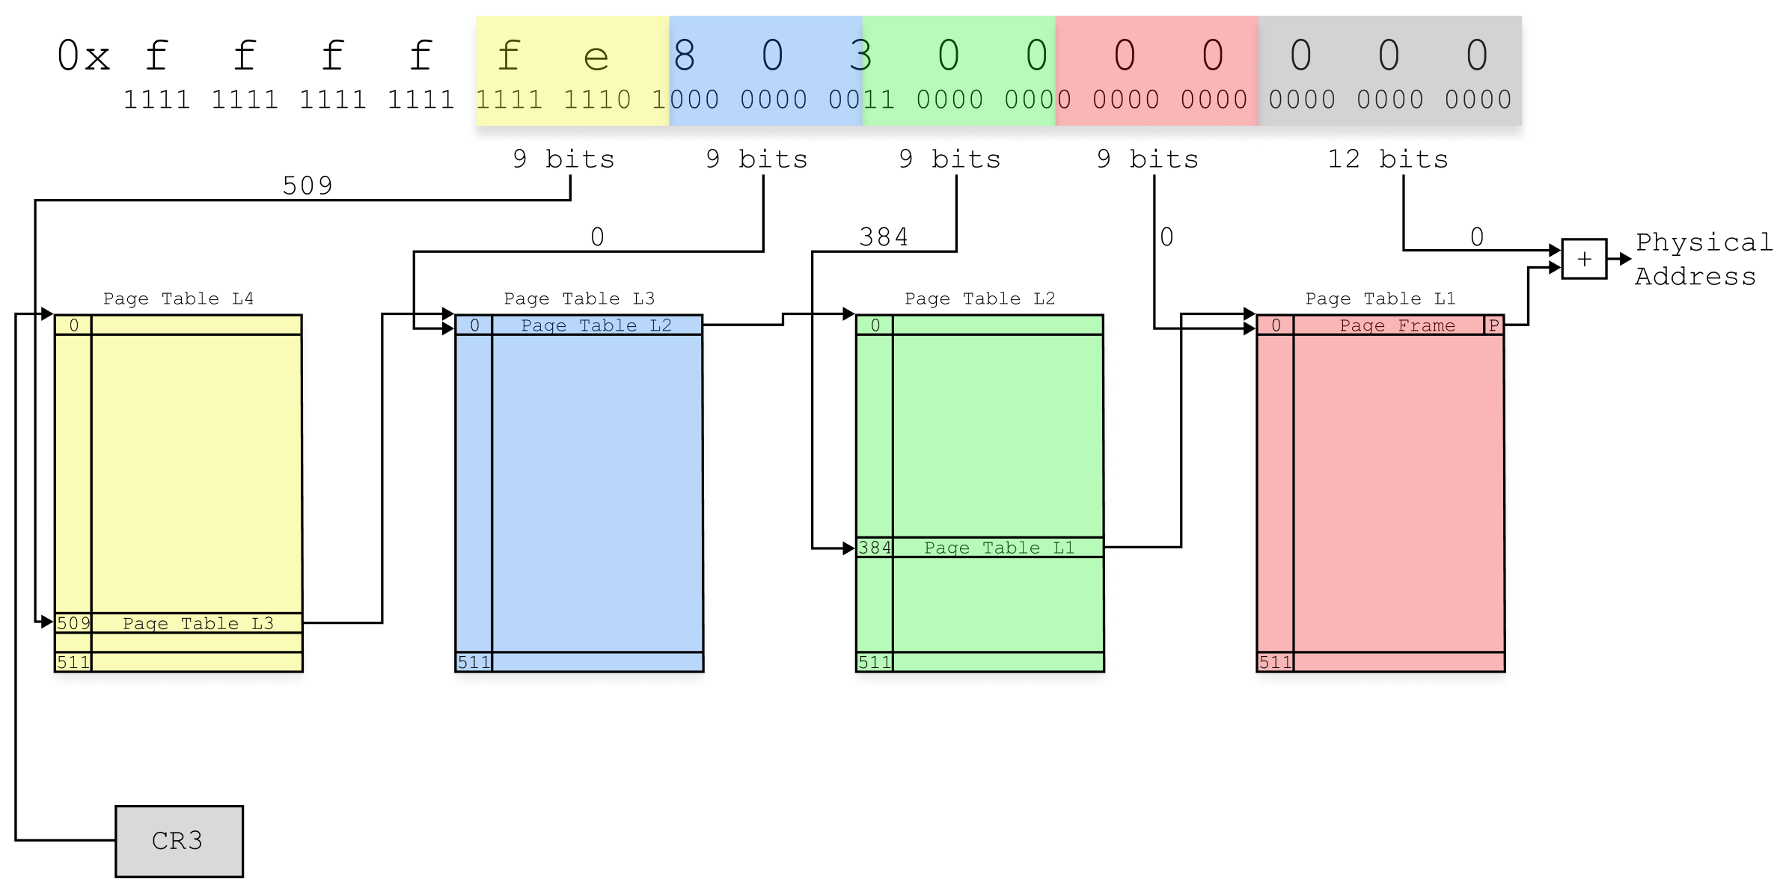
PaX/grsecurity PRIVATE KSTACKS – Page Tables (Before)

Slide 59
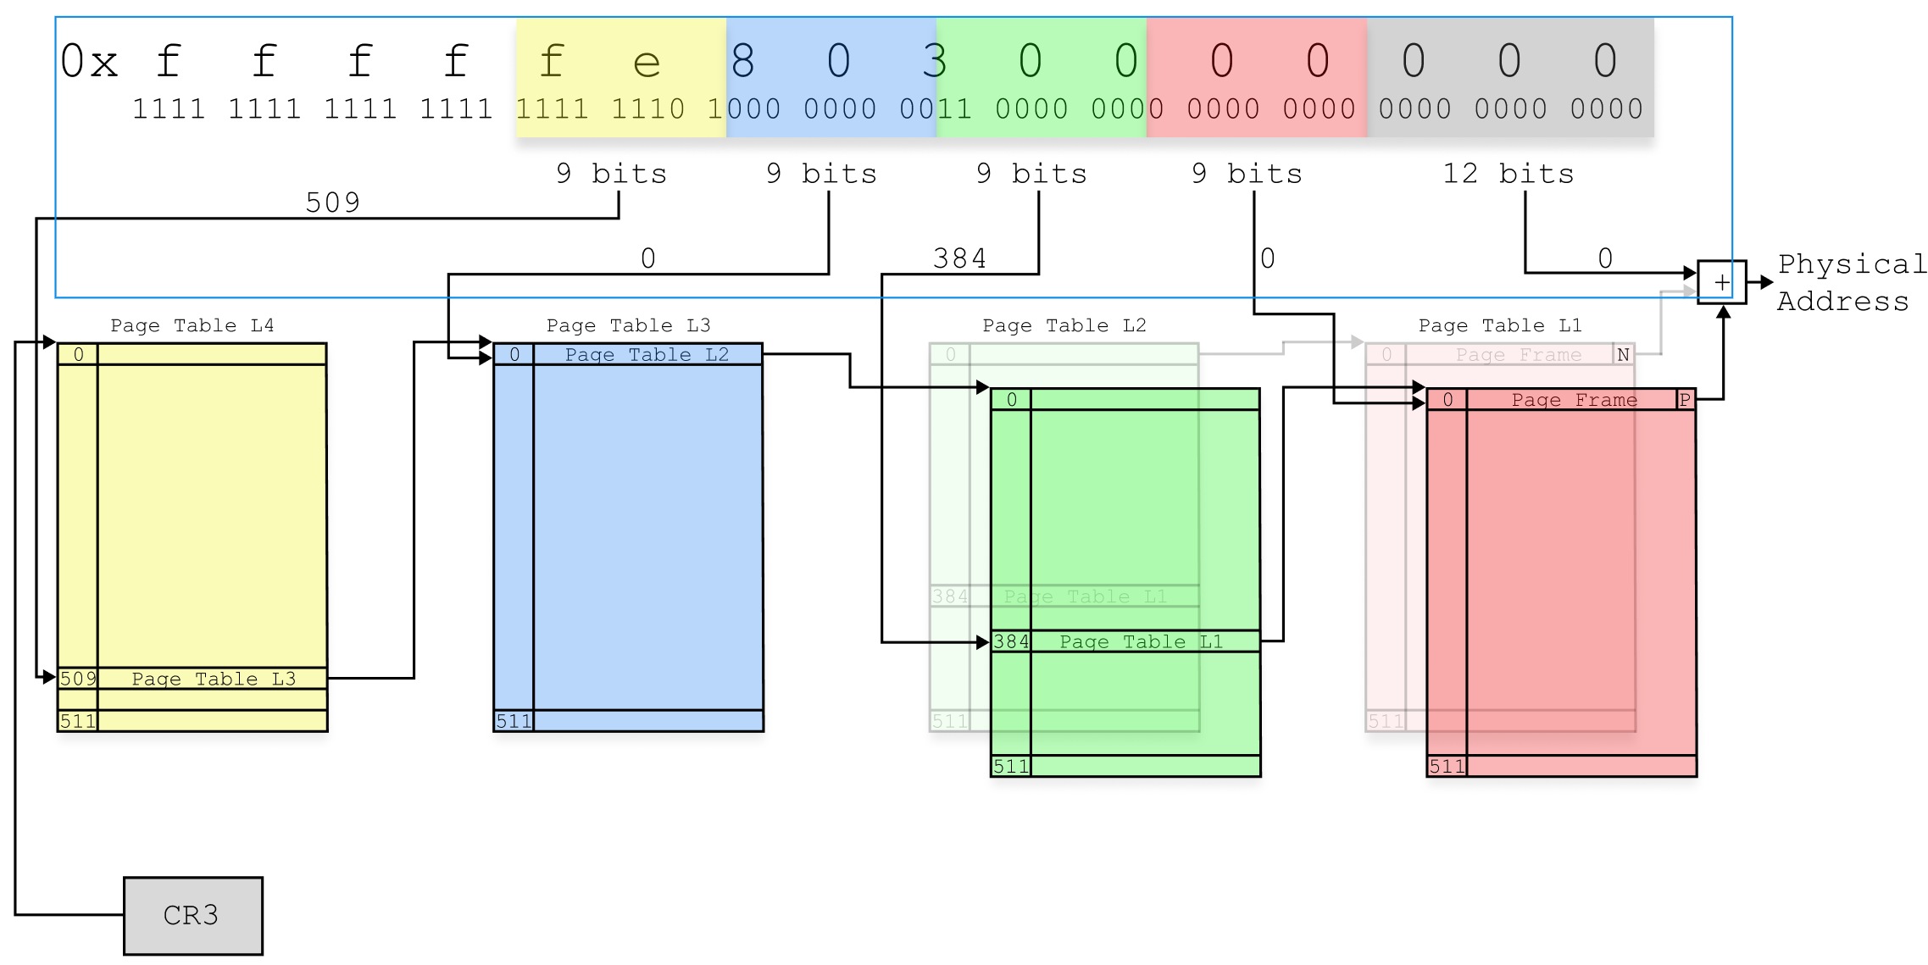
PaX/grsecurity PRIVATE KSTACKS – Page Tables (After)

Slide 60
PaX/grsecurity PRIVATE KSTACKS
That rang a bell…
The paging-structure caches might be at play here…
Also, we weren’t able to reproduce in a VM…
… and VMX transitions do flush the paging-structure caches
But why?
The spurious nature of the #PF indicated that there was no mistake in page tables:
Previously unmapped page does not need invalidation as non-present pages translations are not cached
There was no architectural memory access that could potentially populate the translation caches with previously unmapped 2nd level page table
CPUs of other microarchitectures did not exhibit this problem at all

Slide 61
PaX/grsecurity PRIVATE KSTACKS
Then a couple of documentation snippets caught our eye:
“The use of the PDE cache depends on the paging mode: [...] For 4-level paging, each PDE-cache entry is referenced by a 27-bit value and is used for linear addresses for which bits 47:21 have that value”
“The processor may create an entry in a paging-structure cache even if there are no translations for any linear address that might use that entry. Thus, if software has marked “not present” all entries in a page table, the processor may subsequently create a PDE-cache entry for the PDE that references that page table (assuming that the PDE itself is marked “present”).”
“The processor may create entries in paging-structure caches for translations required for prefetches and for accesses that are a result of speculative execution that would never actually occur in the executed code path.”
“If the processor does not find a relevant TLB entry, it may use the upper bits of the linear address to select an entry from the PDE cache that is associated with the current PCID (Section 4.10.3.1 indicates which bits are used in each paging mode). It can then use that entry to complete the translation process (locating a PTE, etc.)”

Slide 62
PaX/grsecurity PRIVATE KSTACKS
That made us develop a hypothesis:
What if Alderlake CPUs’ E-Cores are more “sensitive” and more likely to create and retain paging-structure caches entries…
… even for the no-translations-requiring page tables…
… merely based on a specific page table pages re-use and access patterns specific to the PRIVATE KSTACKS feature?

Slide 63
PaX/grsecurity PRIVATE KSTACKS
More specifically, what if the following happens:
Previous kernel stack page is unmapped and its translations are invalidated
Current (new) kernel stack page becomes mapped, but does not have any entries in TLB (yet)
The previously used and now unmapped 2nd level page table’s entry remains in paging-structure cache
It has the same indexing bits as the new page table page
When a new kernel stack access triggers a page walk, it uses stale entry from the paging-structure cache
When such misdirected page walk returns a non-present previous kernel stack’s entry:
#PF exception is thrown
When such misdirected page walk returns a present kernel stack’s entry:
A stack data corruption can happen…
… leading to the unexplainable RAP violations we used to observe

Slide 64
PaX/grsecurity PRIVATE KSTACKS – Proof-of-Concept
Let’s test the hypothesis with a PoC…
The PoC presented here is a simplified approximation of the chain of events, that happen during the PRIVATE KSTACKS context switch and that could lead to the unexpected #PF exceptions
Primary objectives of the PoC were:
Prove paging-structure cache involvement and anticipated behavior
Prove the “uniqueness” of the Intel Alderlake CPUs
Same PoC should reproduce only of these CPUs
Reproduce the issue inside a VM, by better controlling of VMX transitions occurrences
Help to develop best (performance-wise) fix for the issue

Slide 65
PaX/grsecurity PRIVATE KSTACKS – Proof-of-Concept
The PoC begins by selecting two arbitrary virtual addresses to become the bases of two distinct address spaces
Then, we allocate and map in the first address space, which consists of 502 consecutive 4K pages

Slide 66
PaX/grsecurity PRIVATE KSTACKS – Proof-of-Concept
Next, we allocate and map in the second address space, which consists of 512 consecutive 4K pages
A full 2MB range
Then, we obtain 2nd level page table entries for both of the base addresses and make a backup of the default content for the second address’ entry

Slide 67
PaX/grsecurity PRIVATE KSTACKS – Proof-of-Concept
Now, we can predict the virtual address of the expected spurious #PF
It is an address of the first unmapped page from the 2MB range of the first address space
Remember: we only mapped in 502 of 4K pages

Slide 68
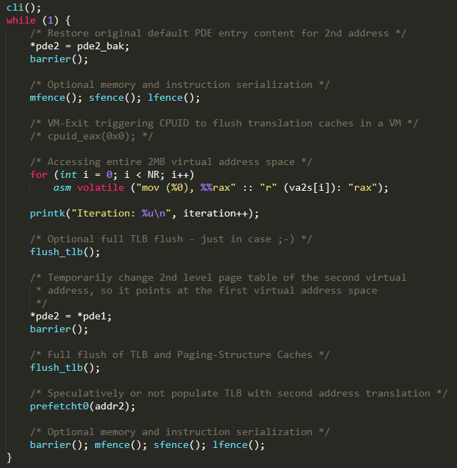
PaX/grsecurity PRIVATE KSTACKS – Proof-of-Concept
Finally, by running the main loop, we should be able to trigger the predicted spurious #PF exception
The loop does the following…
At its second iterations, we should hit the paging-structure cache collision…

Slide 69
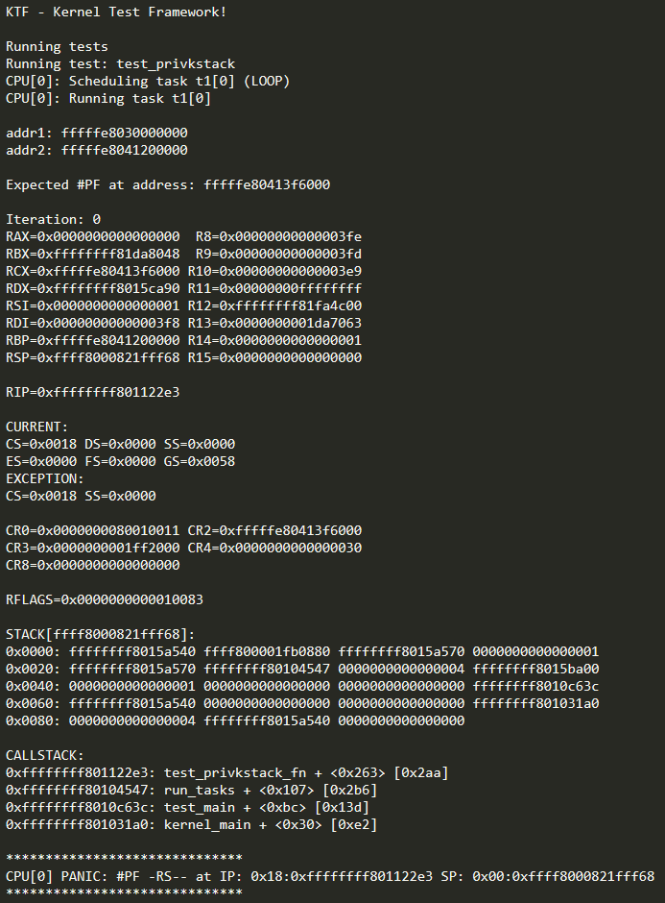
PaX/grsecurity PRIVATE KSTACKS – Proof-of-Concept
And there we have it!

Slide 70
PaX/grsecurity PRIVATE KSTACKS – Proof-of-Concept
Summary:
The higher-level page table entries can be cached in paging-structure caches whenever CPU decides to do so
When aliasing and/or collision in translation caches can occur: invalidation is a must
That’s why Intel SDM recommends the “at least one INVLPG instruction” invalidation
Otherwise page walk can be optimized and bad things could happen

Slide 71
Broken INVLPG instruction on Intel Gracemont microarchitecture

Slide 72
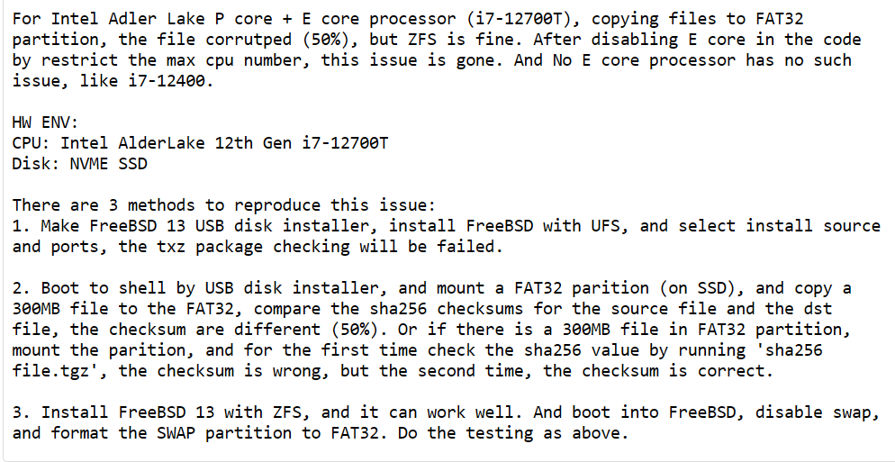
Broken INVLPG instruction case
Around the same time, a FreeBSD received a bug report
261169 – Intel Alder Lake: data corruption with Read&Write files to FAT32 or UFS

Slide 73
Broken INVLPG instruction case
Some time later FreeBSD received a fix for the issue:
https://cgit.freebsd.org/src/commit/?id=cde70e312c3fde5b37a29be1dacb7fde9a45b94a

Slide 74
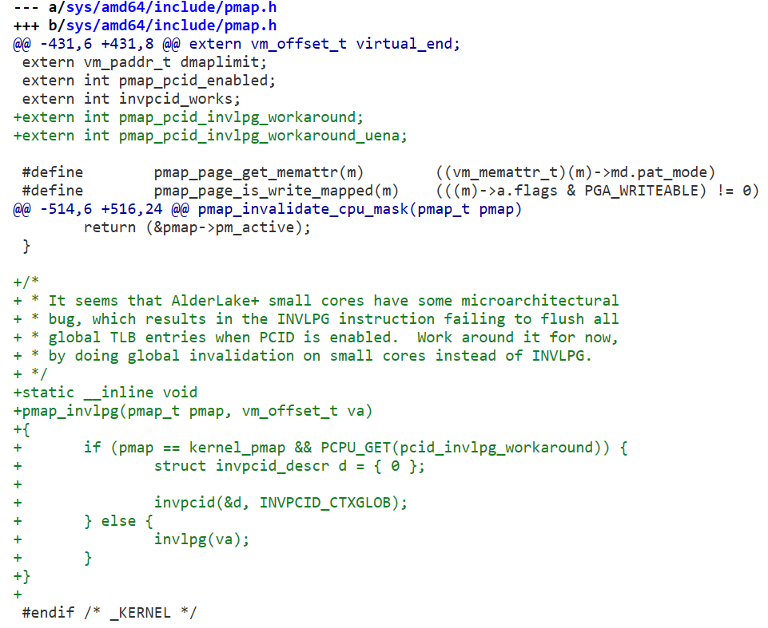
Broken INVLPG instruction case
What does the fix do?
Replaces INVLPG instruction usage with INVPCID, because the INVLPG instruction apparently does not flush all global TLB entries when PCID is enabled!
Despite it should!

Slide 75
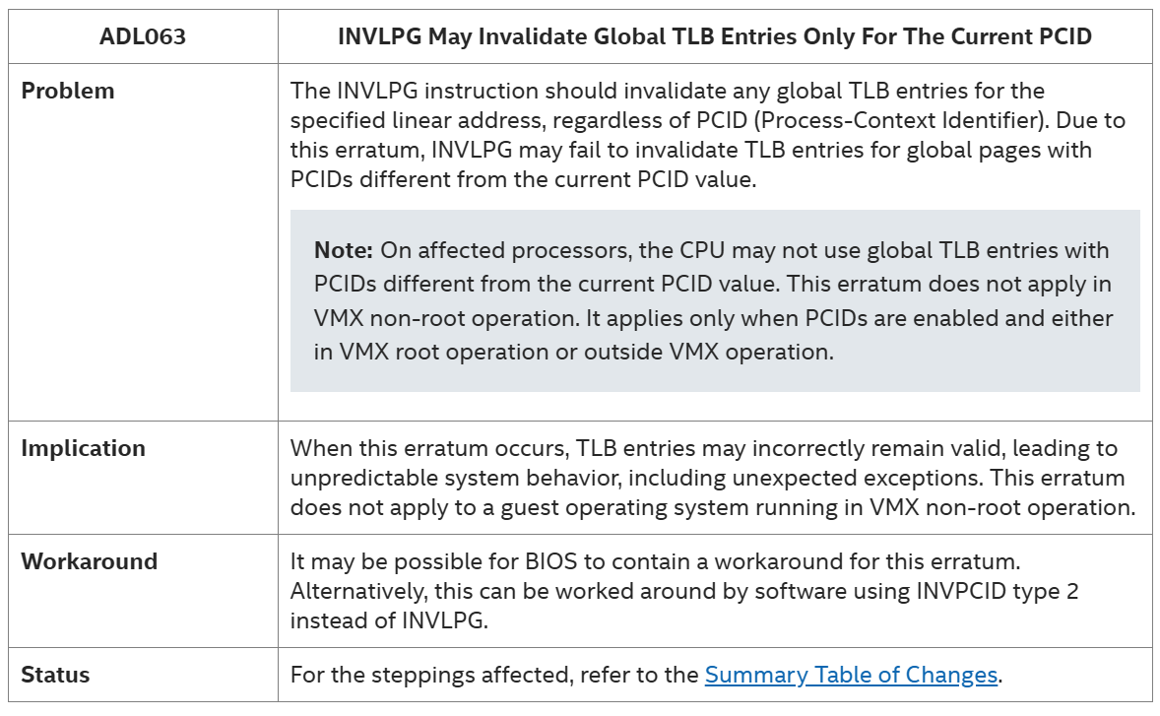
Broken INVLPG instruction case
Then, Intel publishes an erratum for the affected processors:
Errata Details - 027 - ID:682436 | 12th Generation Intel® Core™ Processor

Slide 76
Broken INVLPG instruction case
The plot thickens…
Intel confirmed the incorrect behavior of INVLPG instruction, but also …
Intel mentioned that the INVLPG instruction only fails to flush global TLB entries when PCID is enabled and outside of the VMX virtualized environment!
What was the natural conclusion?
That this was the same bug we were having with PRIVATE KSTACKS
There were just too many coincidences…

Slide 77
Broken INVLPG instruction case
But, there was also a couple of serious “buts”…
The PCID being enabled or disabled did not play a role for the PRIVATE KSTACKS bug at all
And more importantly: unlike FreeBSD, we do not use global pages!
After a careful investigation we were able to conclude that these were indeed two completely separate issues!
One was just a counter-intuitive corner case scenario resulting from specification ambiguity…
… and opaque new hardware microarchitectural modifications!
The other was just a new hardware CPU bug!
A classic situation where nothing is what it seems…

Slide 78
Conclusions
Maintaining coherency between page tables in memory and CPU translation caches is complex
Even if only correctness is kept in mind
It becomes much harder when optimizing for performance
Documentation is ambiguous, imprecise and lacks important details
Probably on purpose: vendors do not want to reveal implementation details
Sometimes, something that seems to be a CPU bug, is just a convoluted, counter-intuitive and super rare corner case scenario manifestation
Other times, the convoluted, counter-intuitive and super rare corner case scenario manifestation is nothing but a CPU bug
No magic wand

Slide 79
Thank you
wipawel@grsecurity.net

